Slide 1
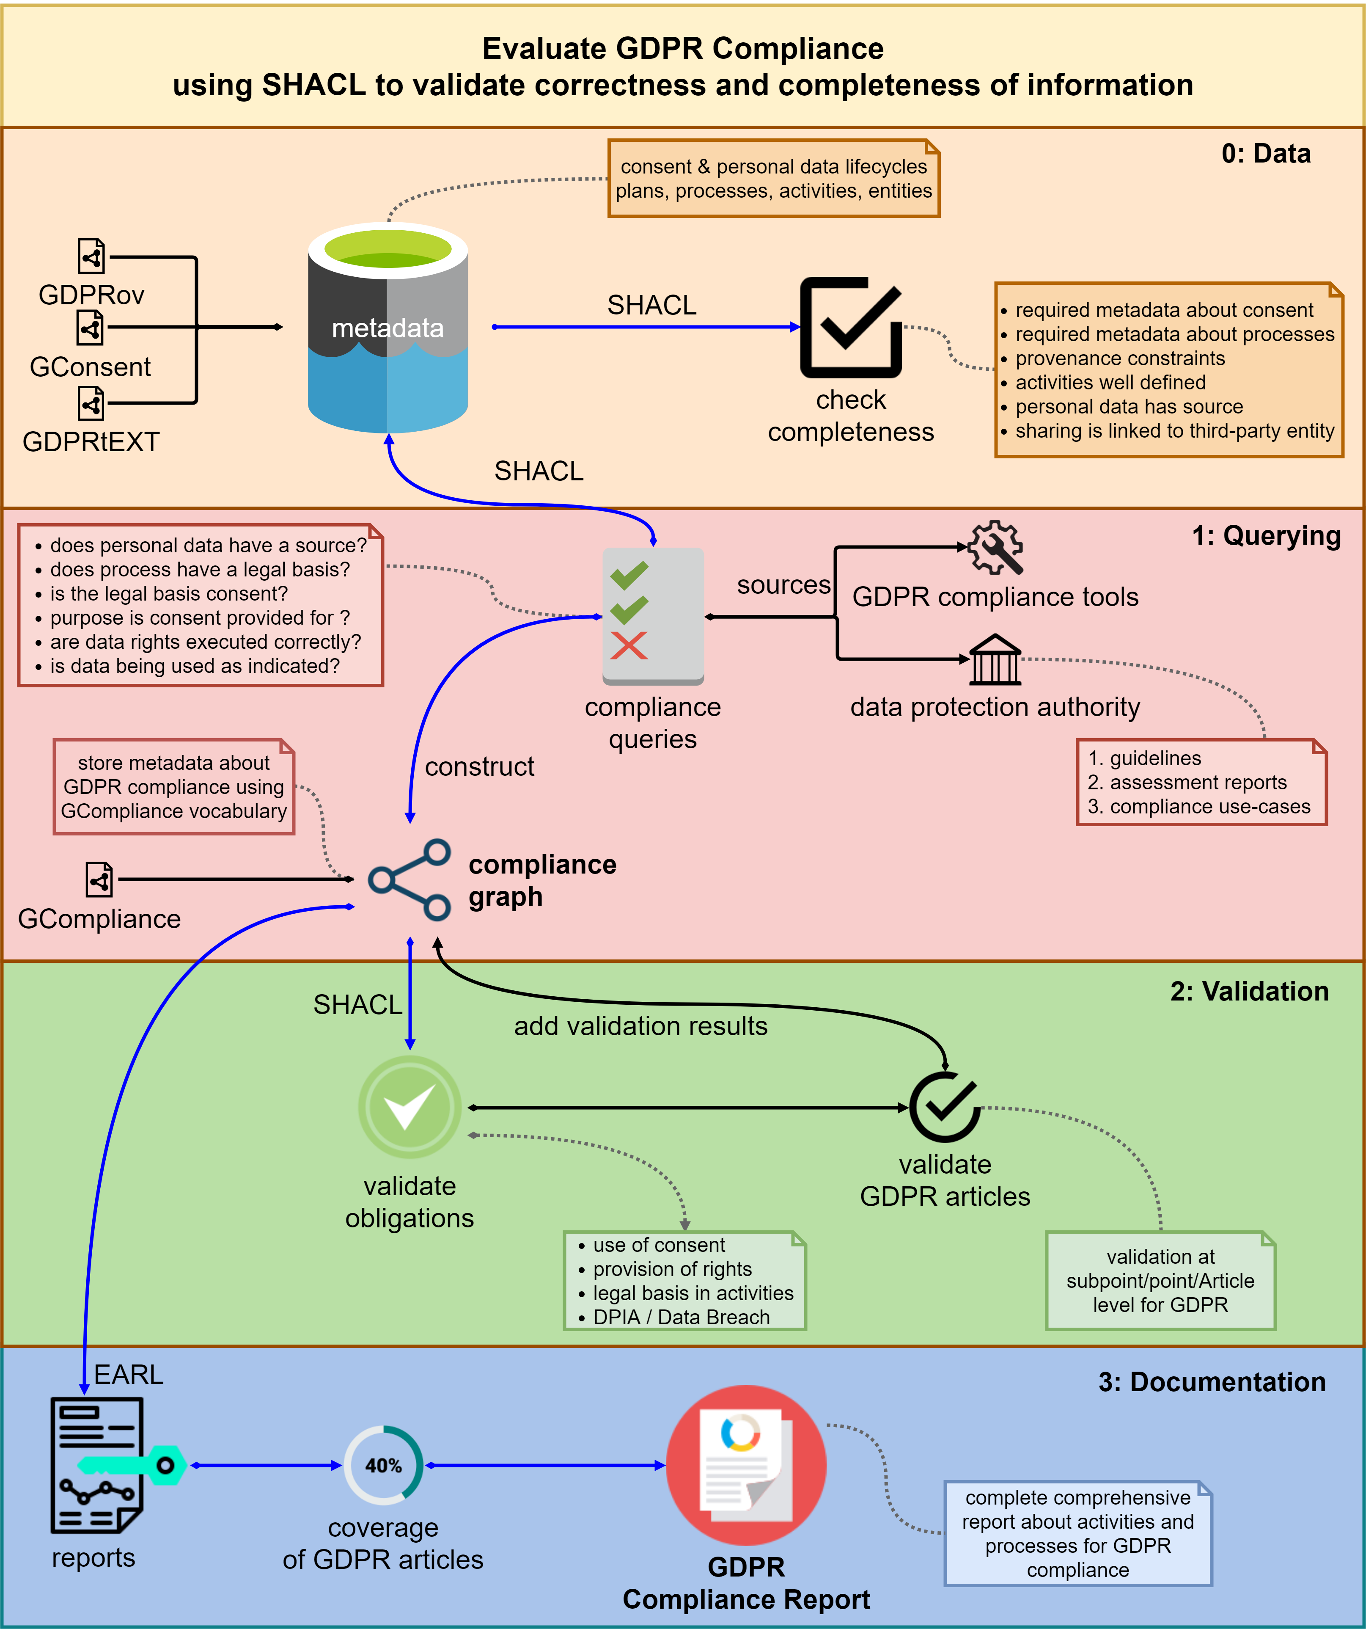
Exploring GDPR Compliance Over Provenance Graphs Using SHACL
Harshvardhan J. Pandit, Declan O'Sullivan, Dave Lewis
ADAPT Centre, Trinity College Dublin, Dublin, Ireland { harshvardhan.pandit | declan.osullivan | dave.lewis } @ adaptcentre.ie
@coolharsh55 https://openscience.adaptcentre.ie/
The ADAPT Centre for Digital Content Technology is funded under the SFI Research Centres Programme
(Grant 13/RC/2106) and is co-funded under the European Regional Development Fund.
Notes:
Notes
Do not change font size – check with us if you really cannot make the space work for you

