Slide 1
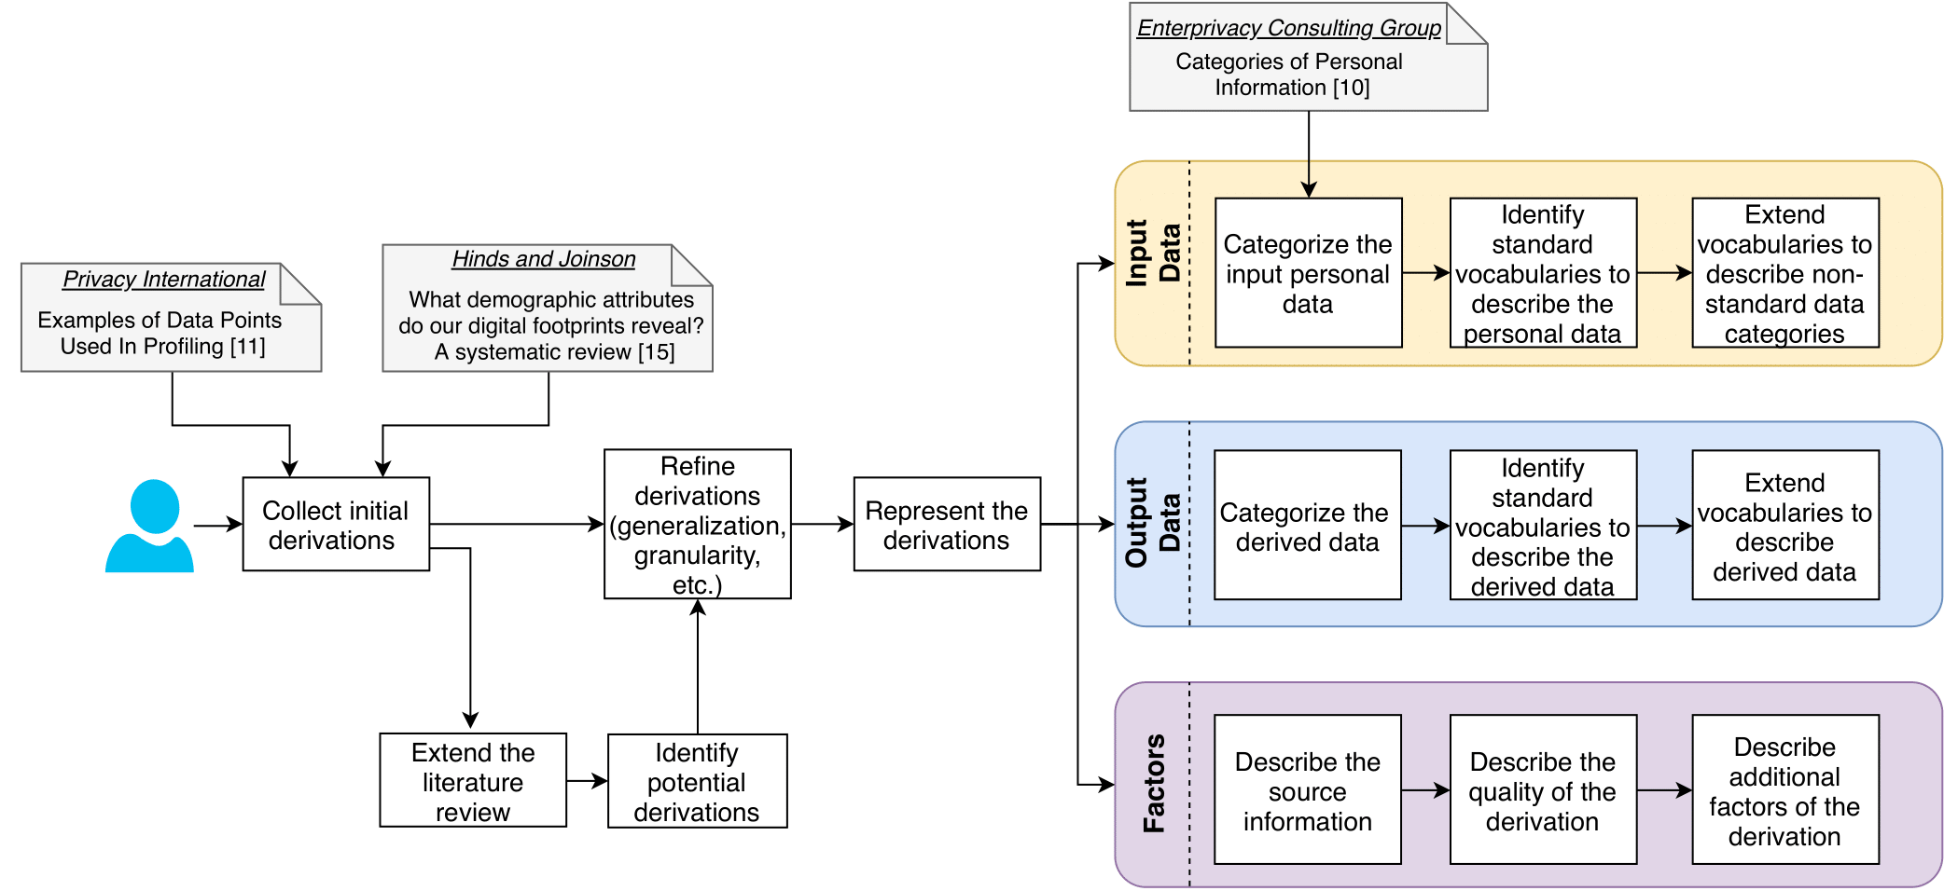
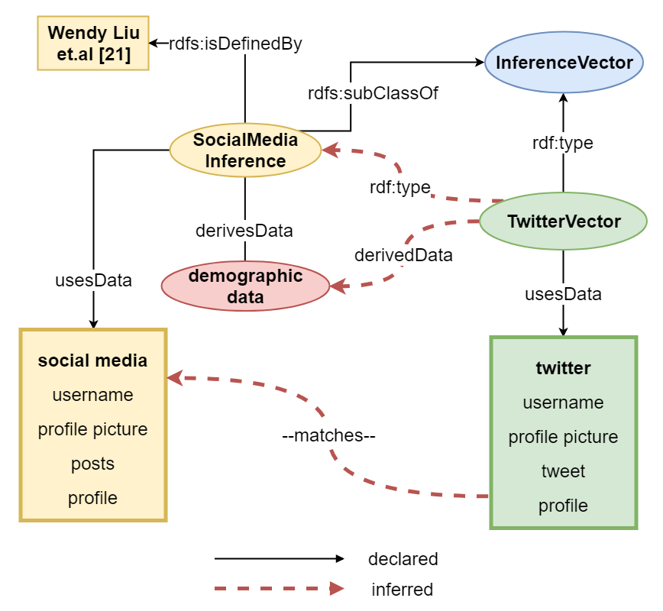
Towards Cataloguing Potential Derivations of Personal Data
Harshvardhan J. Pandit¹, Javier D. Fernandez^{2,3}, Christophe Debruyne¹, and Axel Polleres^{2,3}
¹ ADAPT Centre, Trinity College Dublin, Ireland {pandith | debruync}@tcd.ie
² Vienna University of Economics and Business, Austria
³ Complexity Science Hub Vienna, Austria {jfernand | axel.polleres}@wu.ac.at
repository: github.com/coolharsh55/personal-data-inferences
Did you know that your race, sex, age and political opinion can be inferred from your twitter profile?
Or that demographic data can be inferred from your keyboard and mouse movements?
Aim: Determine and document what additional data can be derived from a given set of personal data
Proof-of-concept:
Create personal data ontology
Define derivations in literature as subclasses rdfs:subClassOf InferenceVector
Associate set of personal data with instance of InferenceVector through usesData TwitterVector rdf:type InferenceVector
Execute HermiT reasoner
Reasoner infers derivations through rdf:type relations between instances and subclasses of InferenceVector
Methodology:
Collect derivations from literature
Refine selected derivations as {input → output[source]}
Represent derivations in RDF+OWL
The bulk of personal data about you is derived data which means it is inferred from some existing data. Information about what data is derived is not transparent, and thus affects the understanding of privacy risks for users. The most famous example is deriving political opinions from tweets and Facebook interactions. This was extensively used by Cambridge Analytica to create psychological profiles for political campaigns based on information derived from users data.
Future Work:
Create a community tool to collect derivations in a central repository
Use SWRL for defining complex rules for derivations
User-study to understand impact of information about derived data on privacy and ethics related risks
Acknowledgements: This work is supported by funding under EU’s Horizon 2020 research and innovation programme: grant 731601 (SPECIAL), the Austrian Research Promotion Agency’s (FFG) program “ICT of the Future”: grant 861213 (CitySPIN), and ADAPT Centre for Digital Excellence funded by SFI Research Centres Programme (Grant 13/RC/2106) and co-funded by European Regional Development Fund.
The ADAPT Centre for Digital Content Technology is funded under the SFI Research Centres Programme
(Grant 13/RC/2106) and is co-funded under the European Regional Development Fund.
Notes:
Notes
Do not change font size – check with us if you really cannot make the space work for you

