Slide 1
Data Privacy Vocabulary (DPV)
Semantics for GDPR and Personal Data Processing
https://w3id.org/dpv
Harsh(vardhan J. Pandit)
Research Fellow @ ADAPT Centre, Trinity College Dublin
Email: pandith@tcd.ie | dpv@harshp.com | Twitter: @coolharsh55
https://harshp.com/research/presentations
Presentation for SEMANTiCS 2022

Slide 2
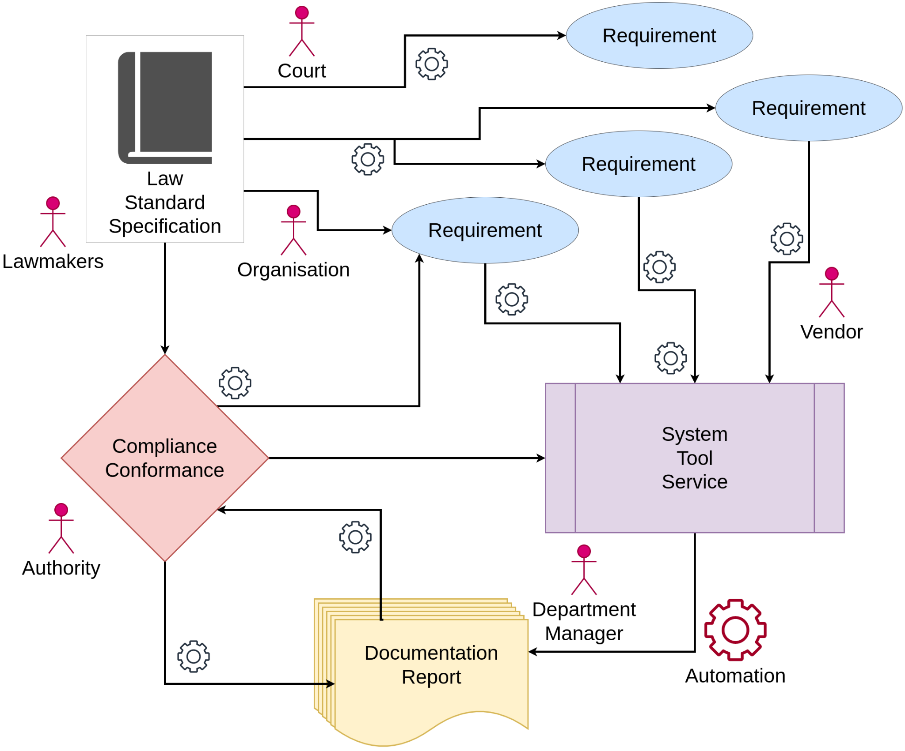
From Compliance Information to Compliance Automation
GDPR Requirement := Maintain Information
Actors := Departments, Authorities, Data Subject, Processor, Controller
Information := Personal Data, Purpose of processing, Implementation details, Storage, Recipients, Technical or Organisational Measures to protect data
1) automation possible only if information is machine-readable
Tasks := Ensure correctness of information, Evaluate compliance
2) solutions can be shared only if information is interoperable
Outputs := Internal Reports, Register of Processing Activities (ROPA), Privacy Notices, Controller-Processor Communications
3) solutions need to be consistent for uniform compliance
Our solution: The Data Privacy Vocabulary (DPV) https://w3id.org/dpv/

Slide 3
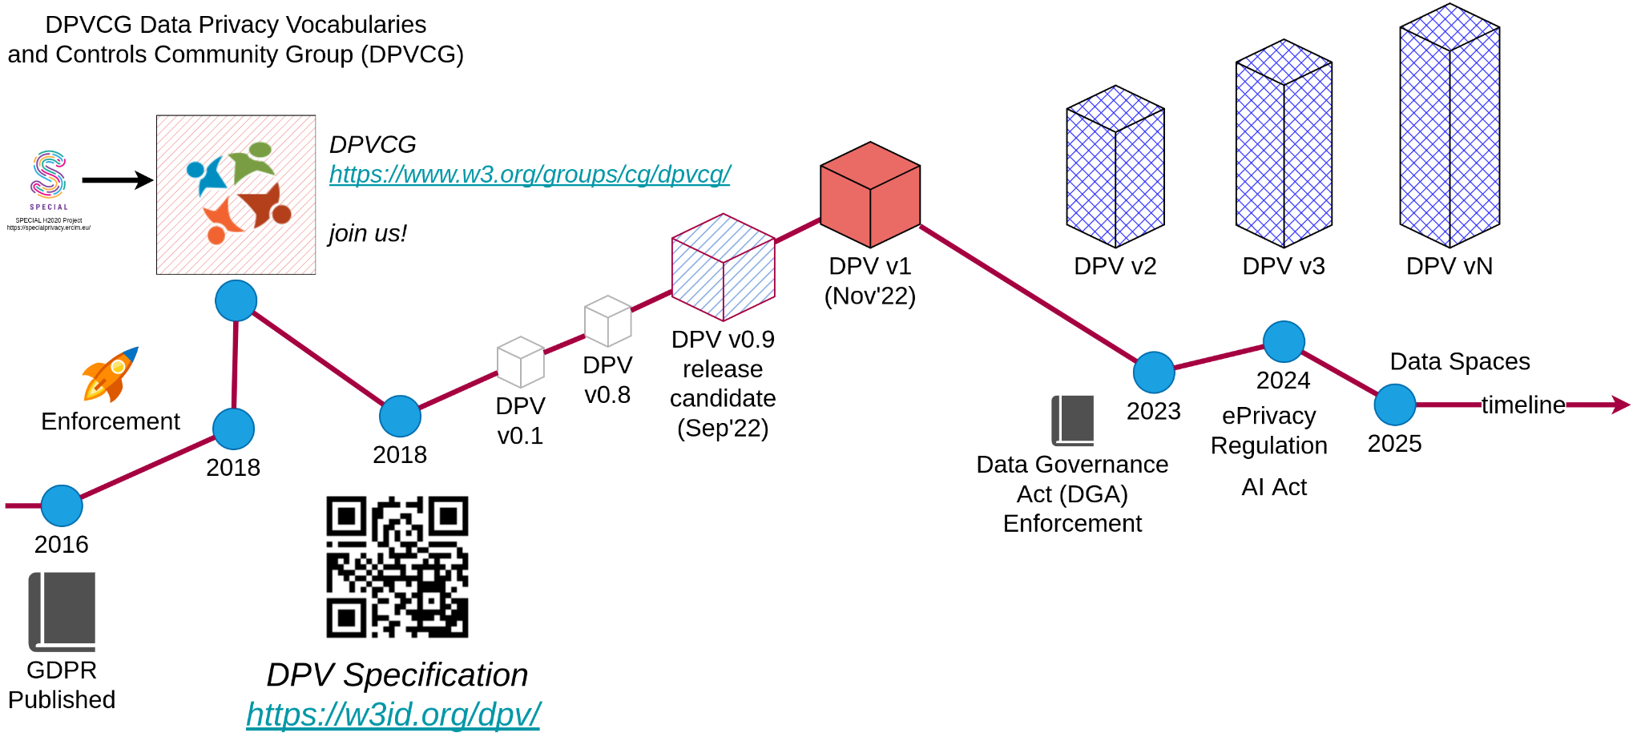
We invite comments and feedbacks for publishing DPV v1 - a significant milestone. See DPV spec for more details. Comment period: up to OCT-15

Slide 4
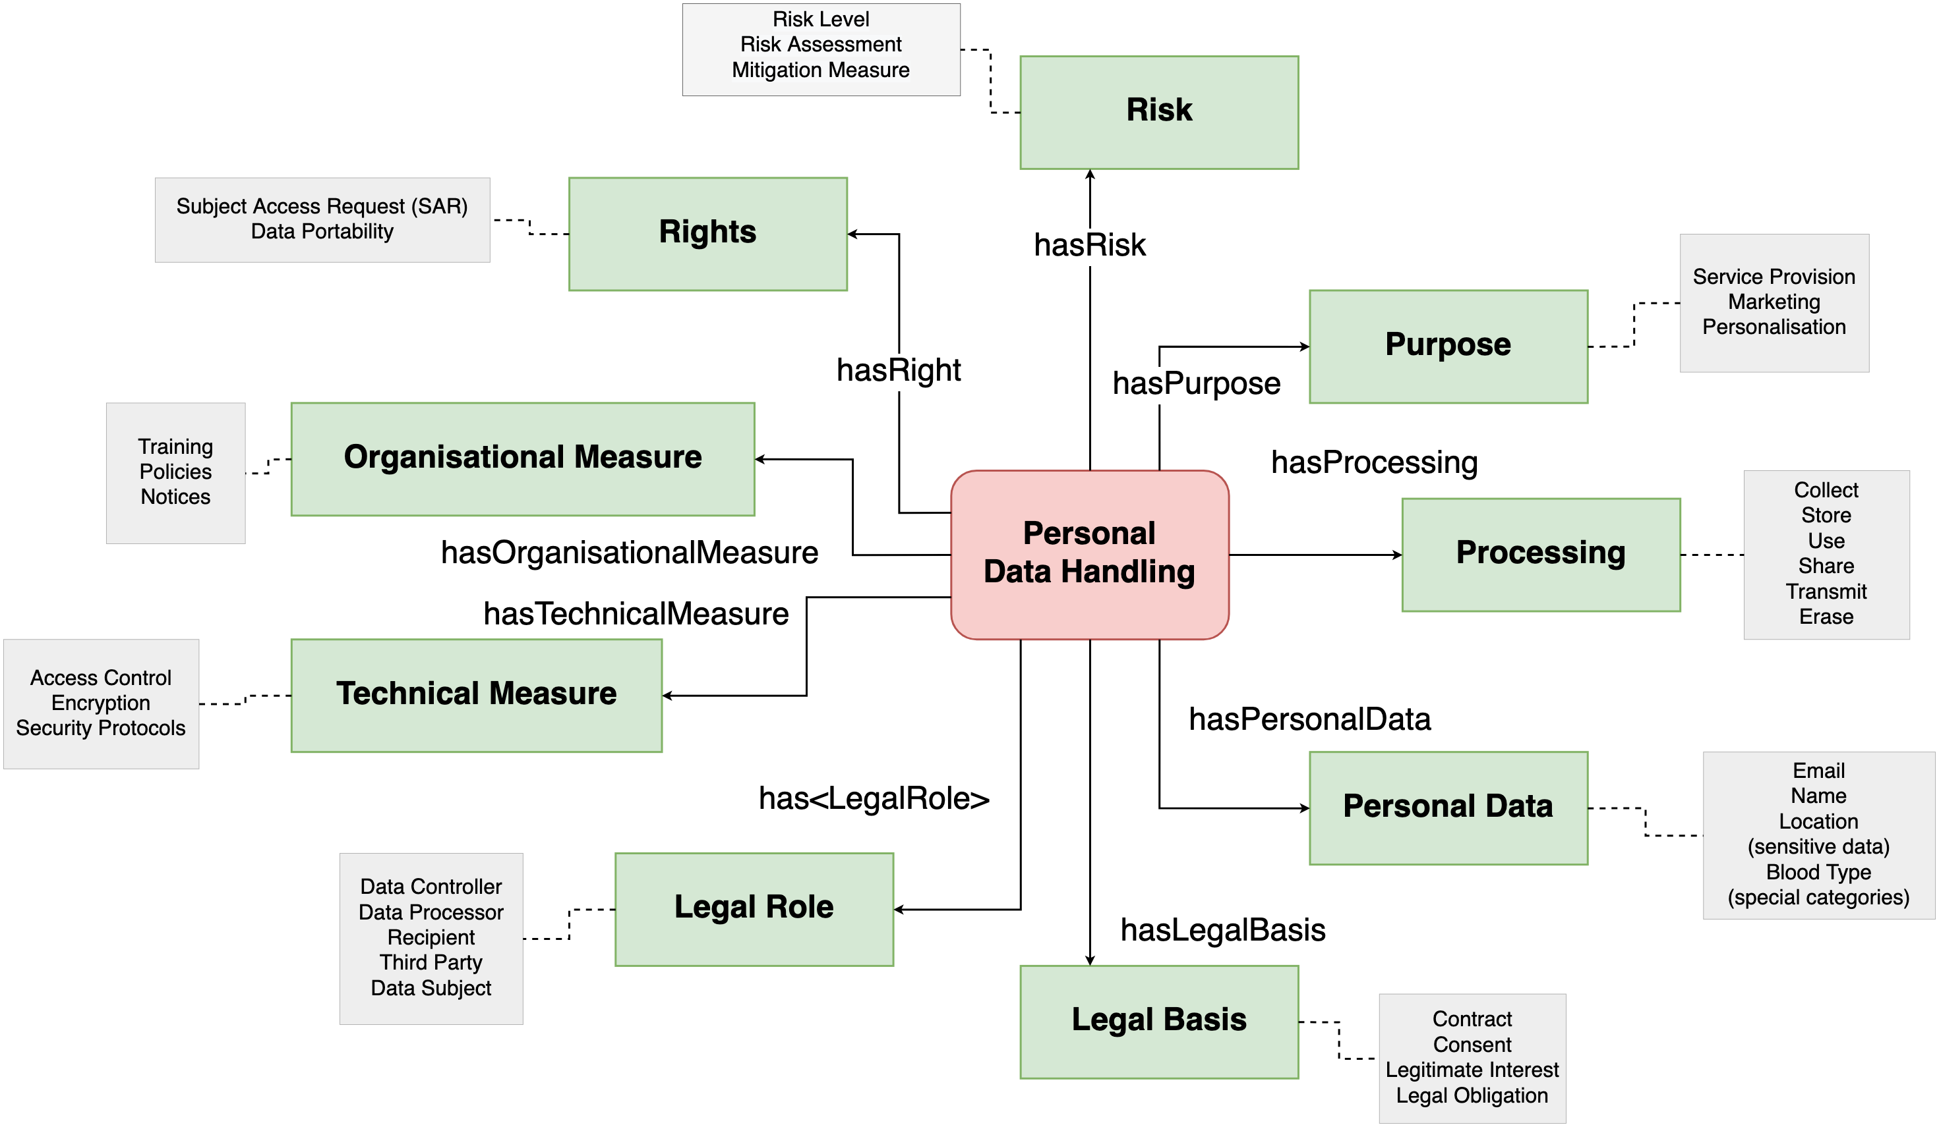
DPV Core Concepts
Serialisations RDF (canonical) CSV, JSON
Semantics RDFS+SKOS OWL2
Purpose Personal Data Processing Legal Basis Legal Role Tech/Org Measures Risk Rights

Slide 5
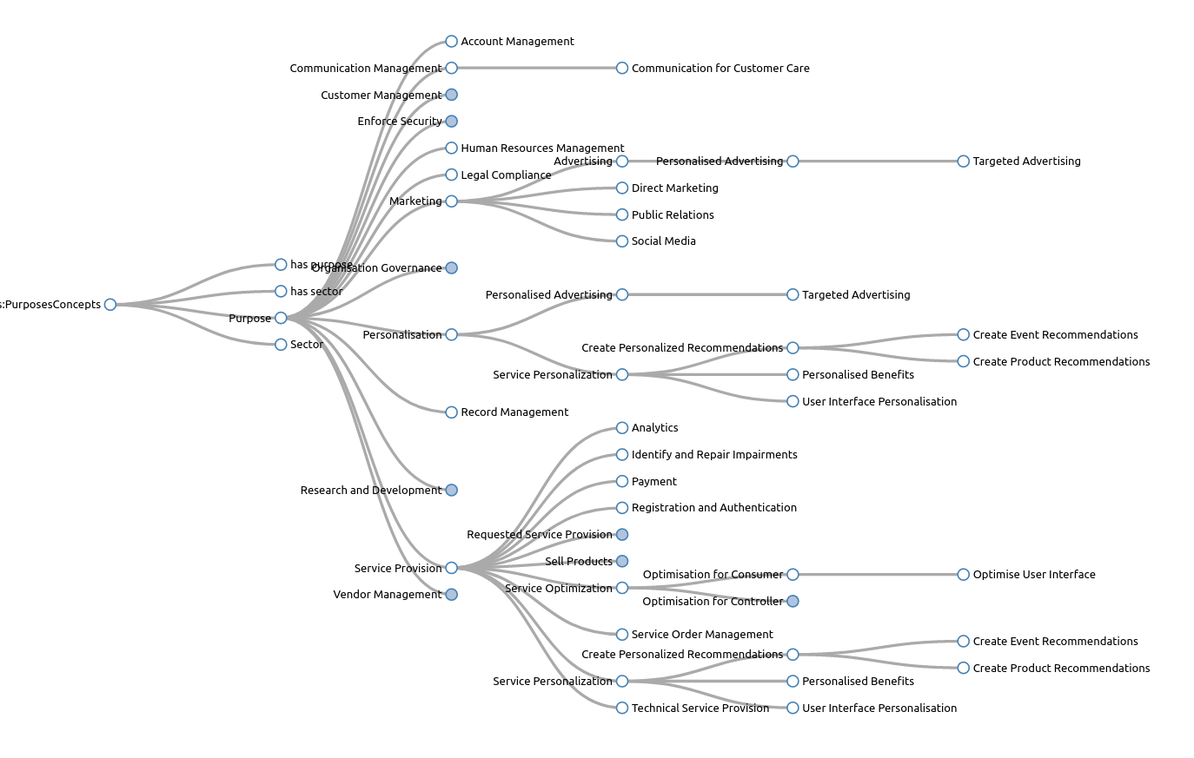
DPV Taxonomies
Use-Case Instances
DPV provides rich hierarchical trees in top-down fashion that go from abstract to more specific concepts
This enables expressing information and rules at both high-levels of abstraction and as specific implementation details
PersonalisedAdvertising
Purpose
TargetedAdvertising
Personalisation
E.g. Purpose taxonomy
Purpose → Personalisation → Personalised Advertising → Targeted Advertising
generated by SKOSPlay https://skos-play.sparna.fr/

Slide 6
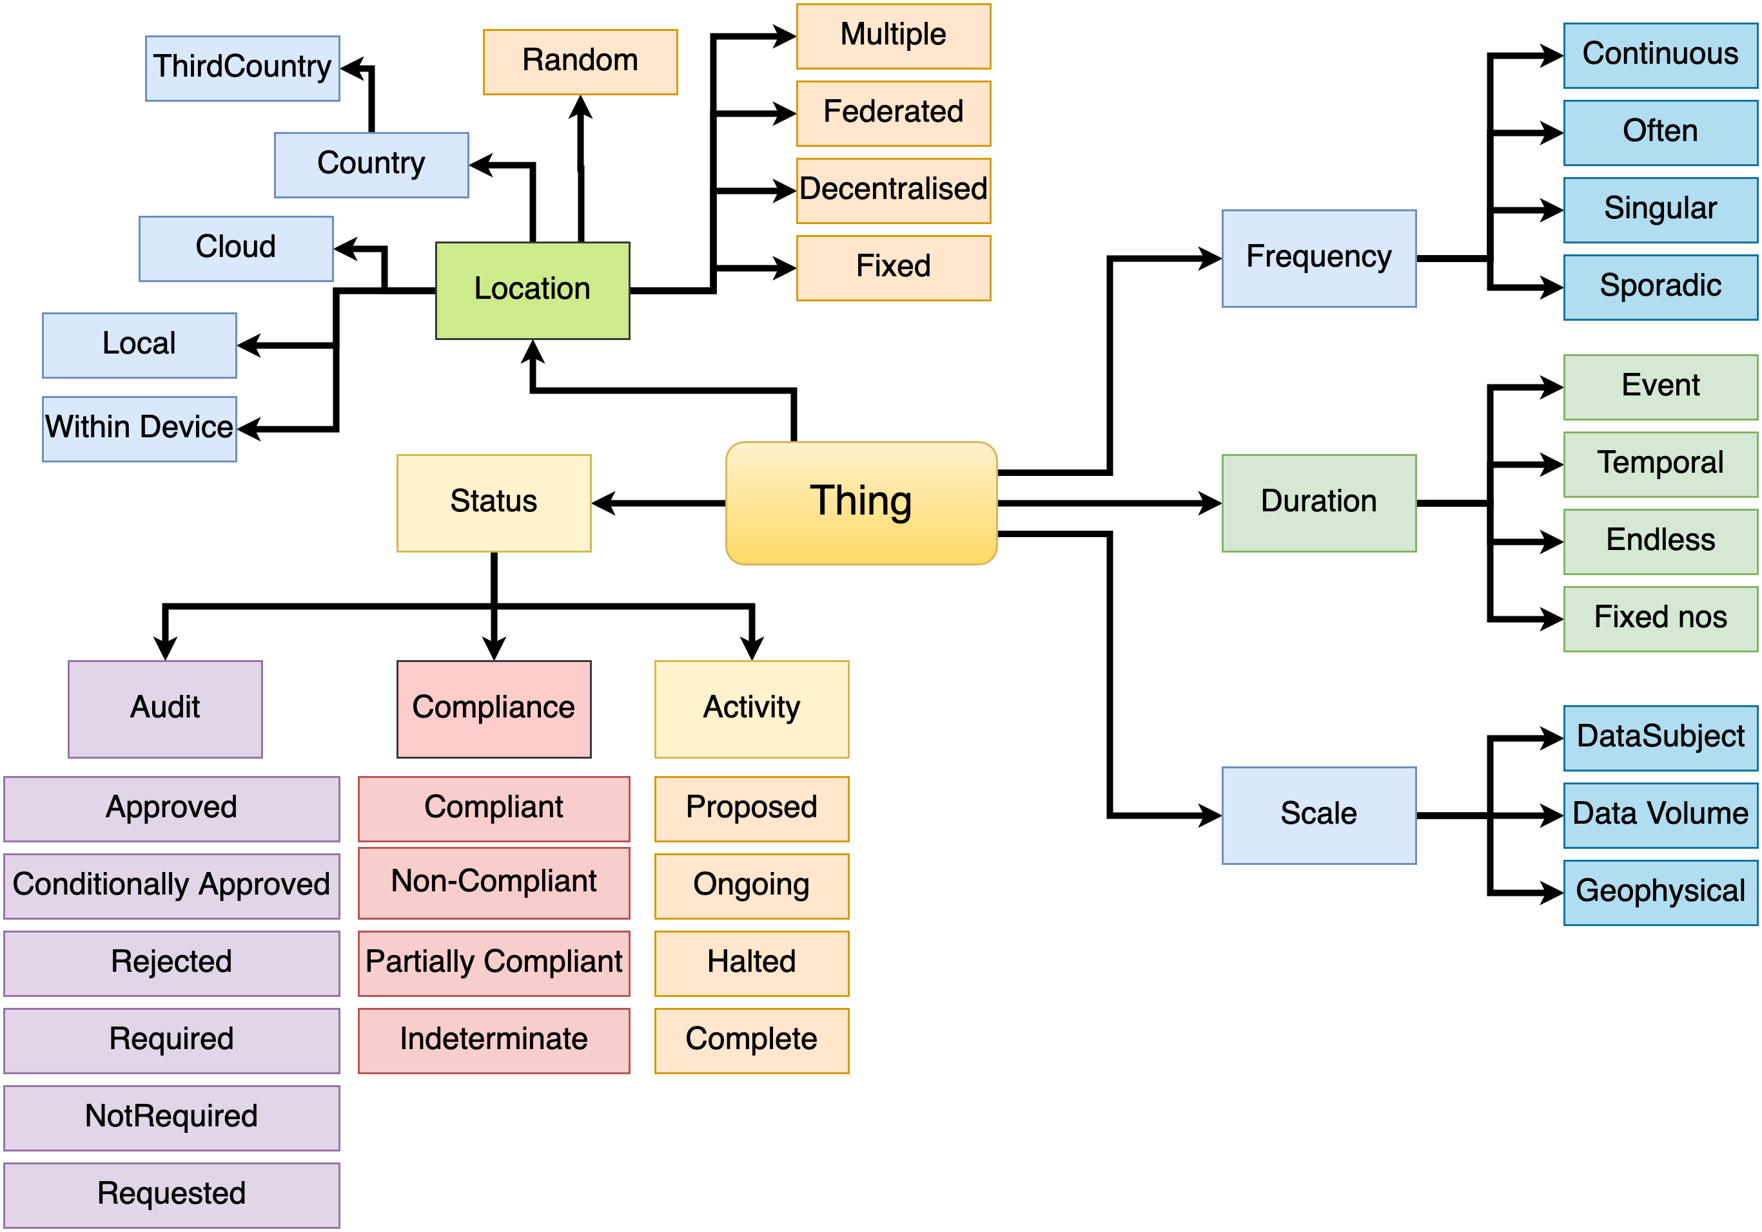
Contextual Information
Duration
Scale
Frequency
Status
Audits
Compliance
Location
Jurisdiction
Adequacy Decisions
Data Source
Automation
Storage conditions
Decision Making
Human Involvement
Consequences & Impacts

Slide 7
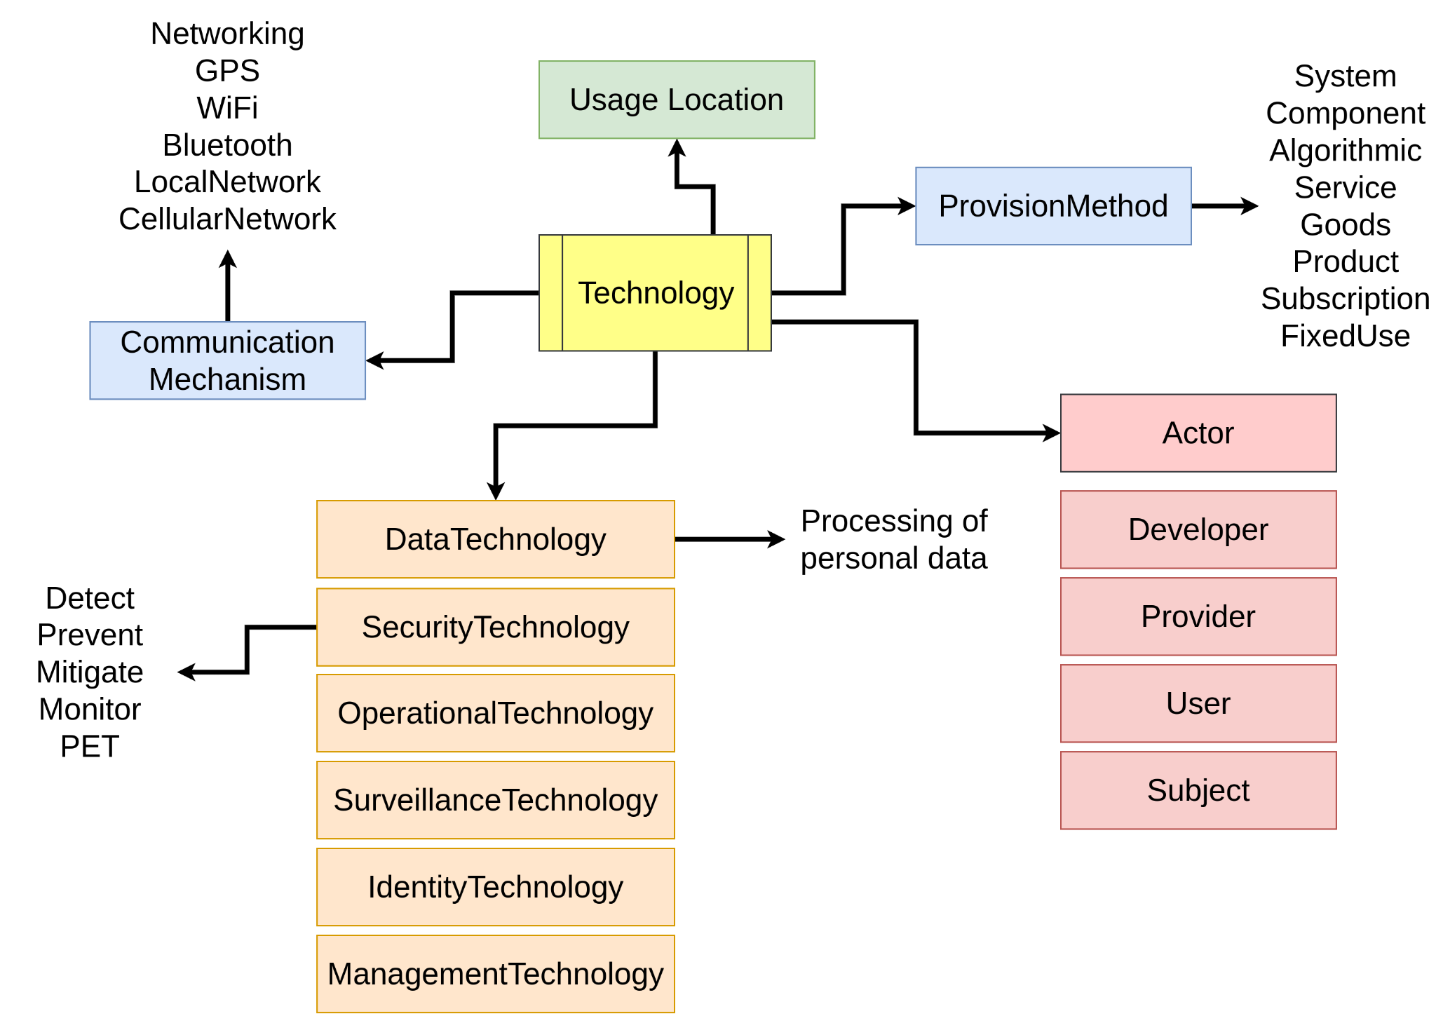
Technologies and Implementations
"Technology" is how you implement a process.
It can be a service, tool, or a system you develop, reuse, or purchase from a vendor.
Representing them is important to provide practical knowledge about personal data and its processing.
"Technology Actors" are an important part of the proposed EU AI Act

Slide 8
DPV Extensions
"Extensions" are additional vocabularies that provide enrichments to concepts defined within DPV (as the primary vocabulary).
Extensions can be rapidly changing concepts, opinionated models, domain or jurisdiction specific taxonomies, or simply provided for convenience.
dpv-pd | Personal Data concepts
dpv-legal | Countries, EU Membership, Laws, Authorities, Adequacy Decision
dpv-tech | Technologies and its provision and functioning
risk | Risk Assessment and Risk Management
rights | Exercising rights, communicating about rights, EU fundamental rights
dpv-gdpr | GDPR specific concepts such as legal bases, data transfer tools, rights

Slide 9
DPV Applications
current work
Register of Processing Activities (ROPA)
Consent Records
Compliance Checking
Impact Assessments (PIA / DPIA)
Data Input/Output Assistance
Annotating code / documents
Expressing and Evaluating Rules
work in progress
Risk Management
Data Breach Records
Subject Access Request
Data Portability
Data Transfers
Privacy Policies
Standards & Guidelines

Slide 10
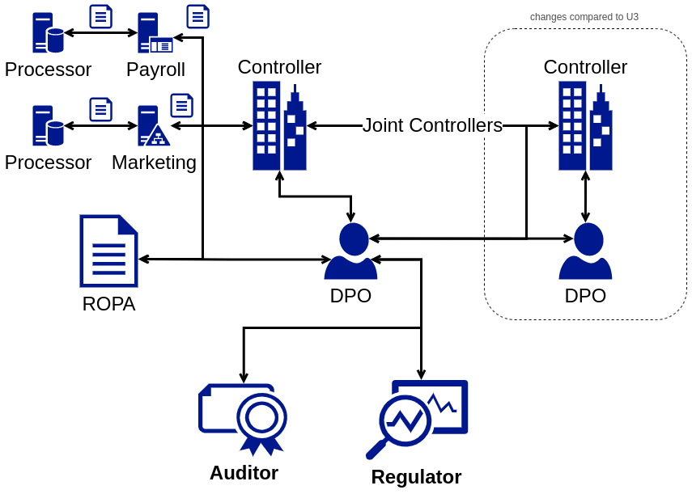
Register of Processing Activities (ROPA)
Information flows between: - Organisational units - DPOs (internal/external) - Controller - Joint-controller - Processor - Auditors - Authorities
DPV enables interoperable solutions for: - intra-organisation data flows - inter-organisation data flows
DPV can be used as: - common language to communicate - internal language to build and use tools

Slide 11
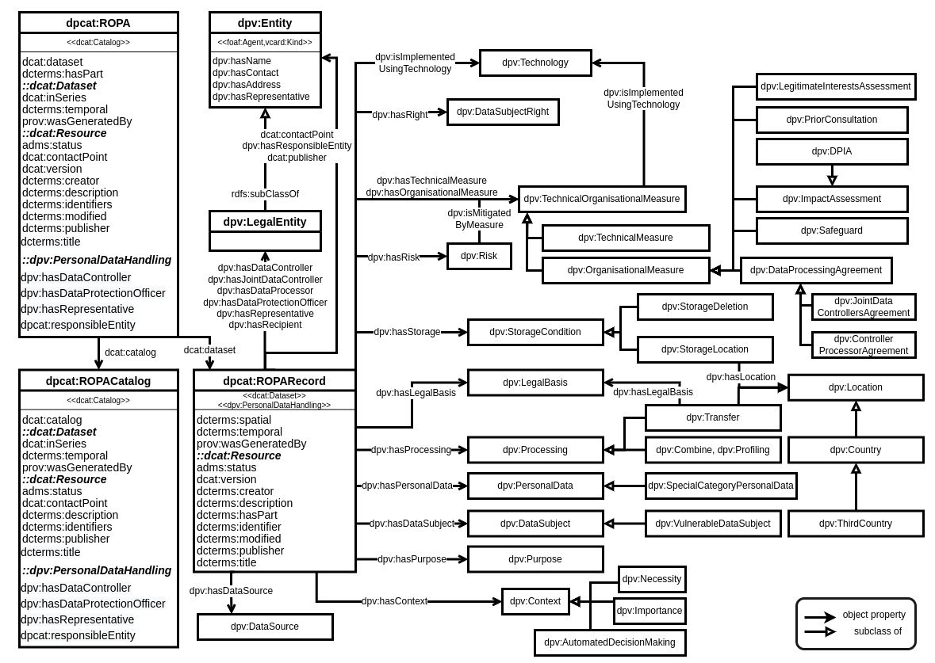
DPCat: Data Processing Catalogue Specification
ROPA as 'information' Use DPV to represent concepts collated from EU DPAs about personal data processing based on GDPR
ROPA as 'information record' Extend DCAT to use ROPA as a dataset that can be packaged and shared and tracked with provenance
ROPA as 'information process' Identify data governance and information flows for GDPR's ROPA based on actors such as controllers, processors, units, DPOs, authorities and use DPV to build solutions for internal use or interoperability
DPCat: Specification for an Interoperable and Machine-Readable Data Processing Catalogue Based on GDPR by P. Ryan, R. Brennan, and H. J. Pandit https://doi.org/10.3390/info13050244

Slide 12
Consent, and Consent Records
:63ded36f-4acd-4f3c-991e-6cb636698523 a dpv:ConsentRecord ;
dct:hasVersion "27560-WD5" ;
dpv:hasIdentifier "63ded36f-4acd-4f3c-991e-6cb636698523" ;
dpv:hasDataSubject "96121fde-199f-4848-8942-4436e270513a" ;
dpv:hasNotice "https://example.com/privacy-notice"^^xsd:anyURI ;
dpv:hasPersonalDataHandling [
a dpv:PersonalDataHandling ;
dct:title "Send Newsletters with Seasonal Offers"@en ;
dpv:hasPurpose dpv:Marketing ;
dpv:hasLegalBasis dpv:Consent ;
dpv:hasPersonalData dpv-pd:Email ;
dpv:hasDataController ex:Acme ;
dpv:hasProcessing dpv:Collect, dpv:Store ;
dpv:hasStorageCondition [
dpv:hasLocation dpv-legal:IE ;
dpv:hasDuration 63115200 ;
] ;
dpv:hasJurisdiction dpv-legal:EU ;
dpv:hasRecipient ex:Beta, ex:Epsilon ;
] ;
dpv:hasConsentStatus dpv:ConsentGiven ;
dct:hasPart [
a dpv:ConsentGiven, dpv:ExplicitlyExpressedConsent ;
dpv:isIndicatedAtTime "2021-05-28T12:24:00"^^xsd:dateTime ;
dpv:hasDuration 63115200 ;
dpv:hasEntity "96121fde-199f-4848-8942-4436e270513a"
] .
One of the most common topics!
DPV (v0.1) initially modelled a simple and straightforward consent model based on common requirements
DPV v0.8+ has comprehensive 'Consent Records' to enable tracking consent forms, events, and use its state in implementations
Intended conformance with standards such as ISO/IEC TR 27560

Slide 13
Rule-based compliance checking
Creation of rules requires domain experts (legal, logic, computing)
Use of rules requires real-world concepts - which DPV's taxonomies provide
Compliance checking can be combination of concepts:
Compliance evaluation can be validation of constraints:
EU H2020 projects have produced several rule checking mechanisms that can be (re-)used, e.g. see SPECIAL, TRAPEZE, MIREL, DAPRECO, BPR4GDPR
implement_process = personal data ^ purpose ^ processing ^ recipient ^ legal basis
[ a sh:NodeShape ; sh:property [ sh:path dpv:hasLegalBasis ; sh:minCount 1 ; ] ]

Slide 14
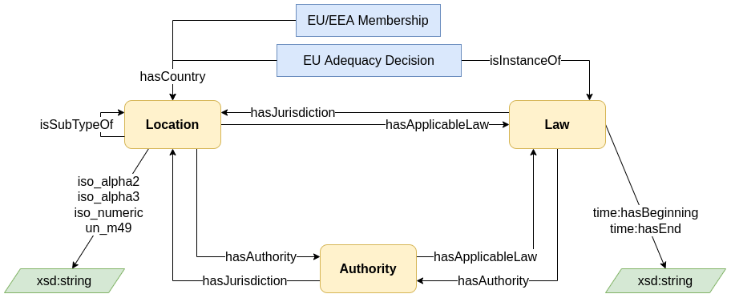
Pan-Jurisdictional KG
Examples of what DPV can be extended with:
dpv-ccpa: CCPA/US concepts and requirements dpv-iso: Aligning DPV concepts with ISO terminology dpv-dga: Modelling Data Governance Act (DGA) as an extension of GDPR (via DPV)
DPV seems to incorporate several concepts from GDPR, but it is not exclusive to it.
DPV concepts are intended to be jurisdiction agnostic, with GDPR specific concepts declared in an extension: DPV-GDPR
Similarly, other extensions can model different jurisdictions and domains by extending from DPV as a base vocabulary.
For specifying instances for different jurisdictions within the same graph, location can be utilised, e.g. <Product> hasJurisdiction B . <Controller> hasJurisdiction C .
The dpv-legal extension helps with pan-jurisdictional information by providing a graph of laws, authorities, etc;

Slide 15
Adoption and Use
SPECIAL H2020 Project https://specialprivacy.ercim.eu/ - policy based compliance and provenance for GDPR
Signatu AS https://signatu.com/ - automated tools and uniform machine-readable compliance
TRAPEZE H2020 Project https://trapeze-project.eu/ - policies and compliance mechanisms for GDPR
smashHit H2020 Project https://smashhit.eu/ - represent consent and contract as a legal KG
MOSAICrOWN H2020 Project https://mosaicrown.eu/ - model data processing as a legal KG
FAIRVASC H2020 Project https://fairvasc.eu/ - represent patient consent information/forms, and DPIAs
GDPR data transfer compliance framework https://doi.org/10.3233/FAIA210332 by D. Hickey & R. Brennan
>>> for more, see https://www.w3.org/community/dpvcg/wiki/Adoption_of_DPVCG

Slide 16
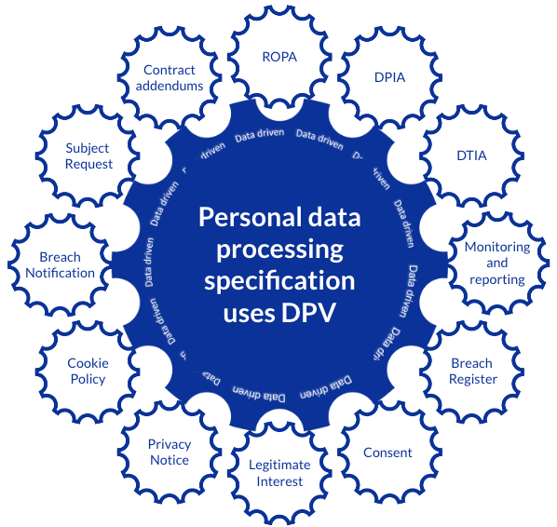
Signatu AS - A SaaS Platform for GDPR
Signatu
simplifies the process of being data protection compliant single specification feeds multiple outputs for any jurisdiction
https://signatu.com/
Signatu delivers INNOVATIVE Legal Compliance and Data Governance as SaaS or Managed Service:
Signatu.com
Data model & Knowledge Graph
Controlled Vocabularies for Use-Cases
Uniform and Reliable Application
Automation for Documentation
Data/Compliance is Machine-readable
Data/Compliance is Interoperable
Data/Compliance can be Queried
Custom Views as Required
Going beyond data lakes/warehouses/silos
https://signatu.com/

Slide 17
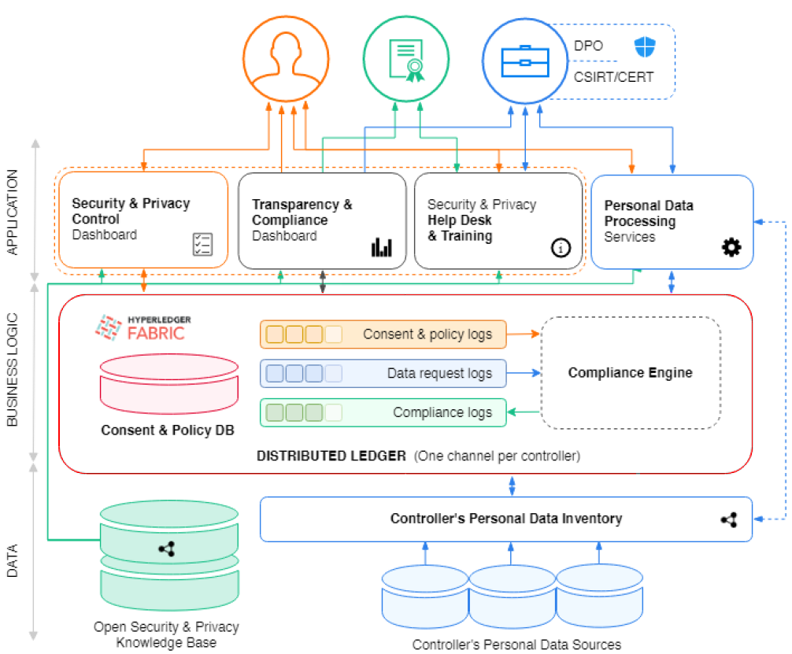
TRAPEZE H2020 Project
https://trapeze-project.eu/
Transparency, Privacy & Security for European Citizens
Uses DPV for creating a semantic policy language that uniformly represents: Privacy policies, data subjects’ consent, data protection regulations
Machine understandable + automated compliance checking using an OWL2 profile that uses formal semantics to provide provably correct compliance (no false positives nor negatives)
Real time compliance checking: ~200 μsec/check
Usability: The employees of TRAPEZE’s industrial partners can write their privacy policies
Facilitating adoption: JSON serialisation available (equivalent to OWL2 version)
TRAPEZE Architecture Overview

Slide 18
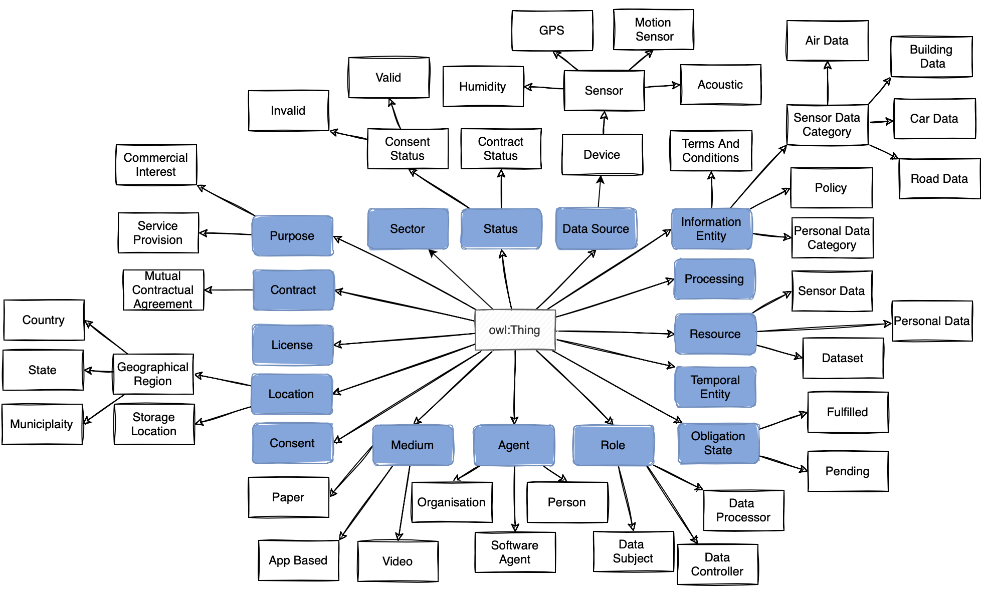
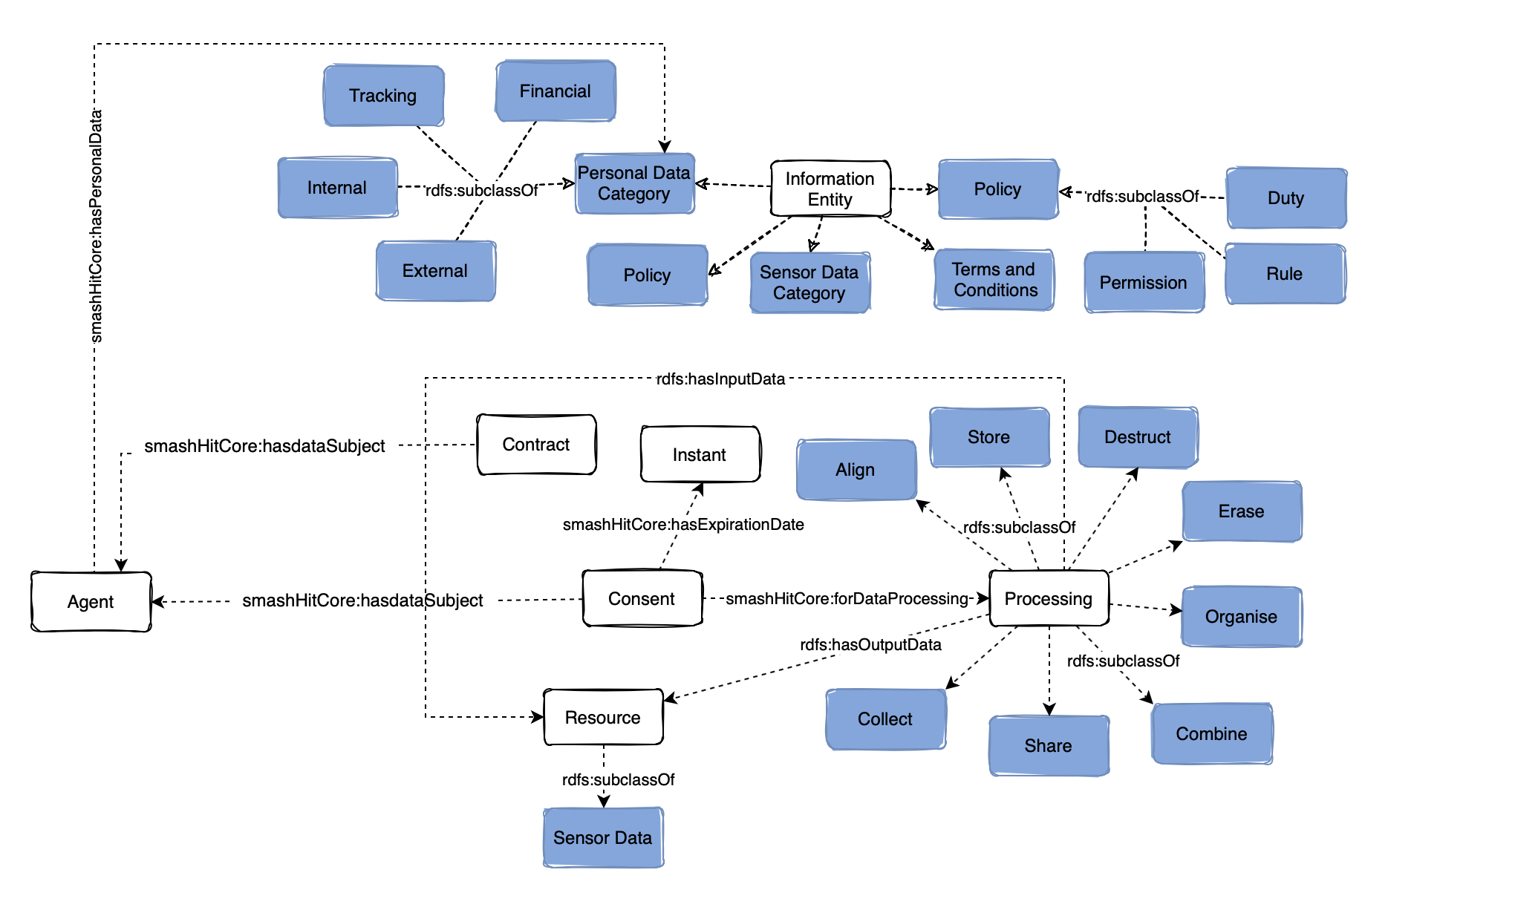
smashHit H2020 project
https://smashhit.eu/
Ontology for GDPR-compliant sensor data sharing in the smart cities and insurance domains that models both consent and contracts as GDPR legal basis for data processing.
Reuses concepts from Data Privacy Vocabulary (DPV) to model personal data, purposes, consent, etc.
smashHitCore is available at
https://gitlab.atb-bremen.de/smashhit/semantic-model

Slide 19
The Data Privacy Vocabulary (DPV) reflects ~5 years of efforts in creating an open resource providing concepts related to personal data processing, privacy, data protection, and GDPR
DPV's taxonomies provide semantic interoperability, which enables new, innovative, smart, and automated solutions
Demonstrated usefulness for important use-cases, e.g. ROPA, consent, compliance checking
We're looking to the future! DGA / ePR / AI-Act / Data Spaces

Slide 20
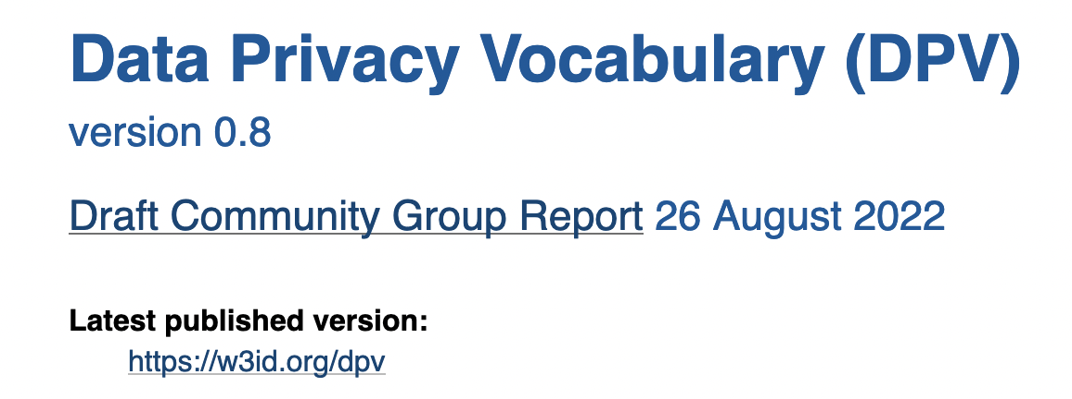
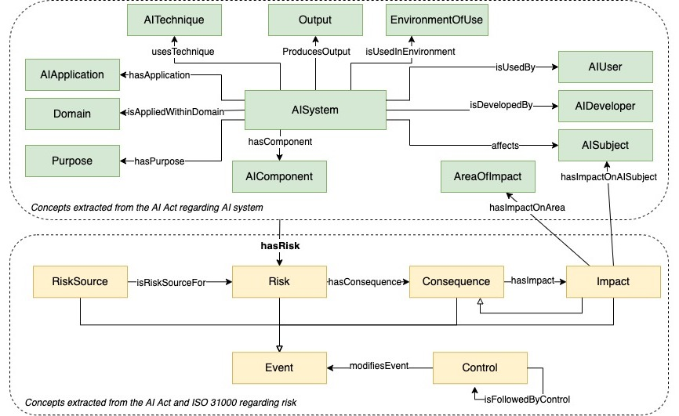
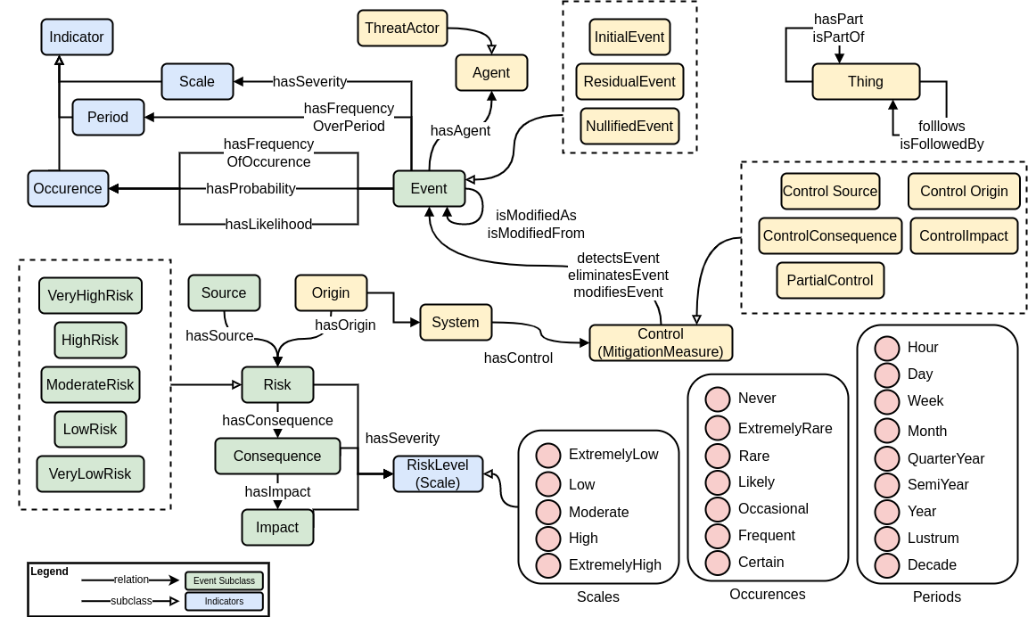
interested? questions? contact at:
DPV Specification https://w3id.org/dpv
Github https://github.com/w3c/dpv/ Joining DPVCG https://www.w3.org/community/dpvcg/
We invite comments and feedbacks for publishing DPV v1 - a significant milestone. See DPV spec for more details. Comment period: up to OCT-15
twitter@coolharsh55 pandith@tcd.ie
dpv@harshp.com
public-dpvcg@w3.org
AI Risk Management based on AI Act Session 2.3 WED 12:45 Lohengrin (3)
DPV for DPIA & Risk Management Session 7.3 THU 15:40 Lohengrin (3)
more @ SEMANTiCS

